Slide 1
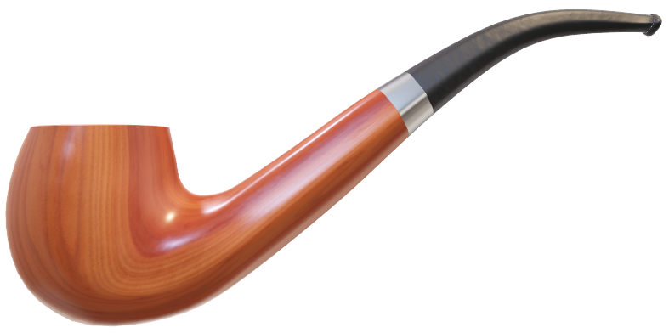
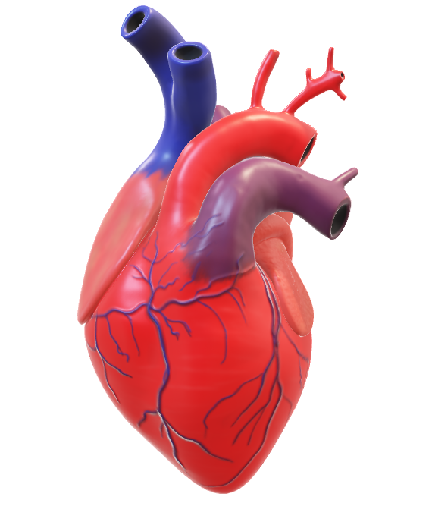
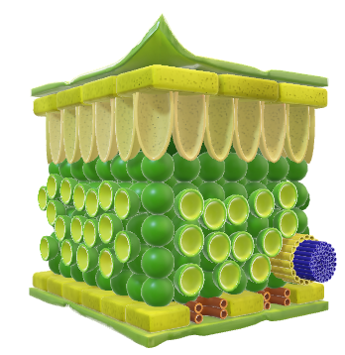
Binary Prediction of Smoker Status using Bio-Signals
Team Explorers
DataSource
Walter Reade, Ashley Chow. (2023). Binary Prediction of Smoker Status using Bio-Signals. Kaggle. https://kaggle.com/competitions/playground-series-s3e24

Slide 2
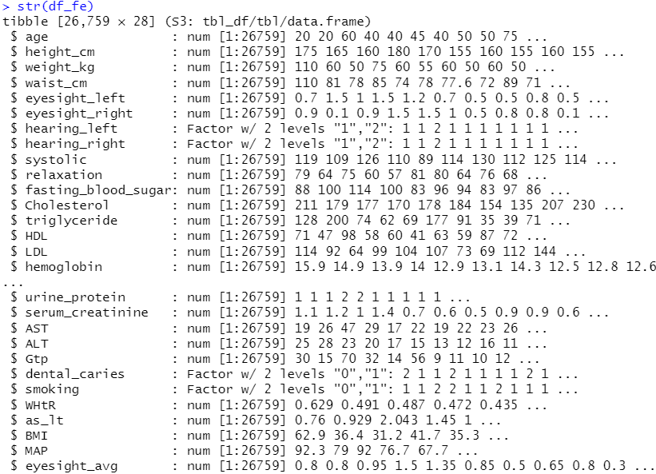
Available Data Variables and Featured Data Variables
Original Features
Target
Engineered Features

Slide 3
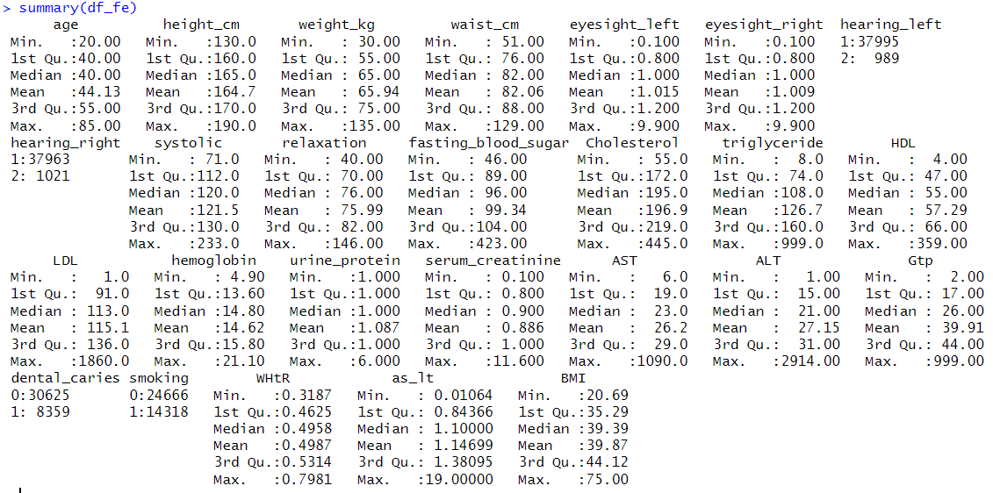

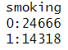
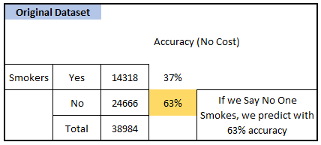
No Cost Prediction :p
Say all are Non-Smokers
and
You’re correct 63% times.
Can We Do Better than this ?

Slide 4
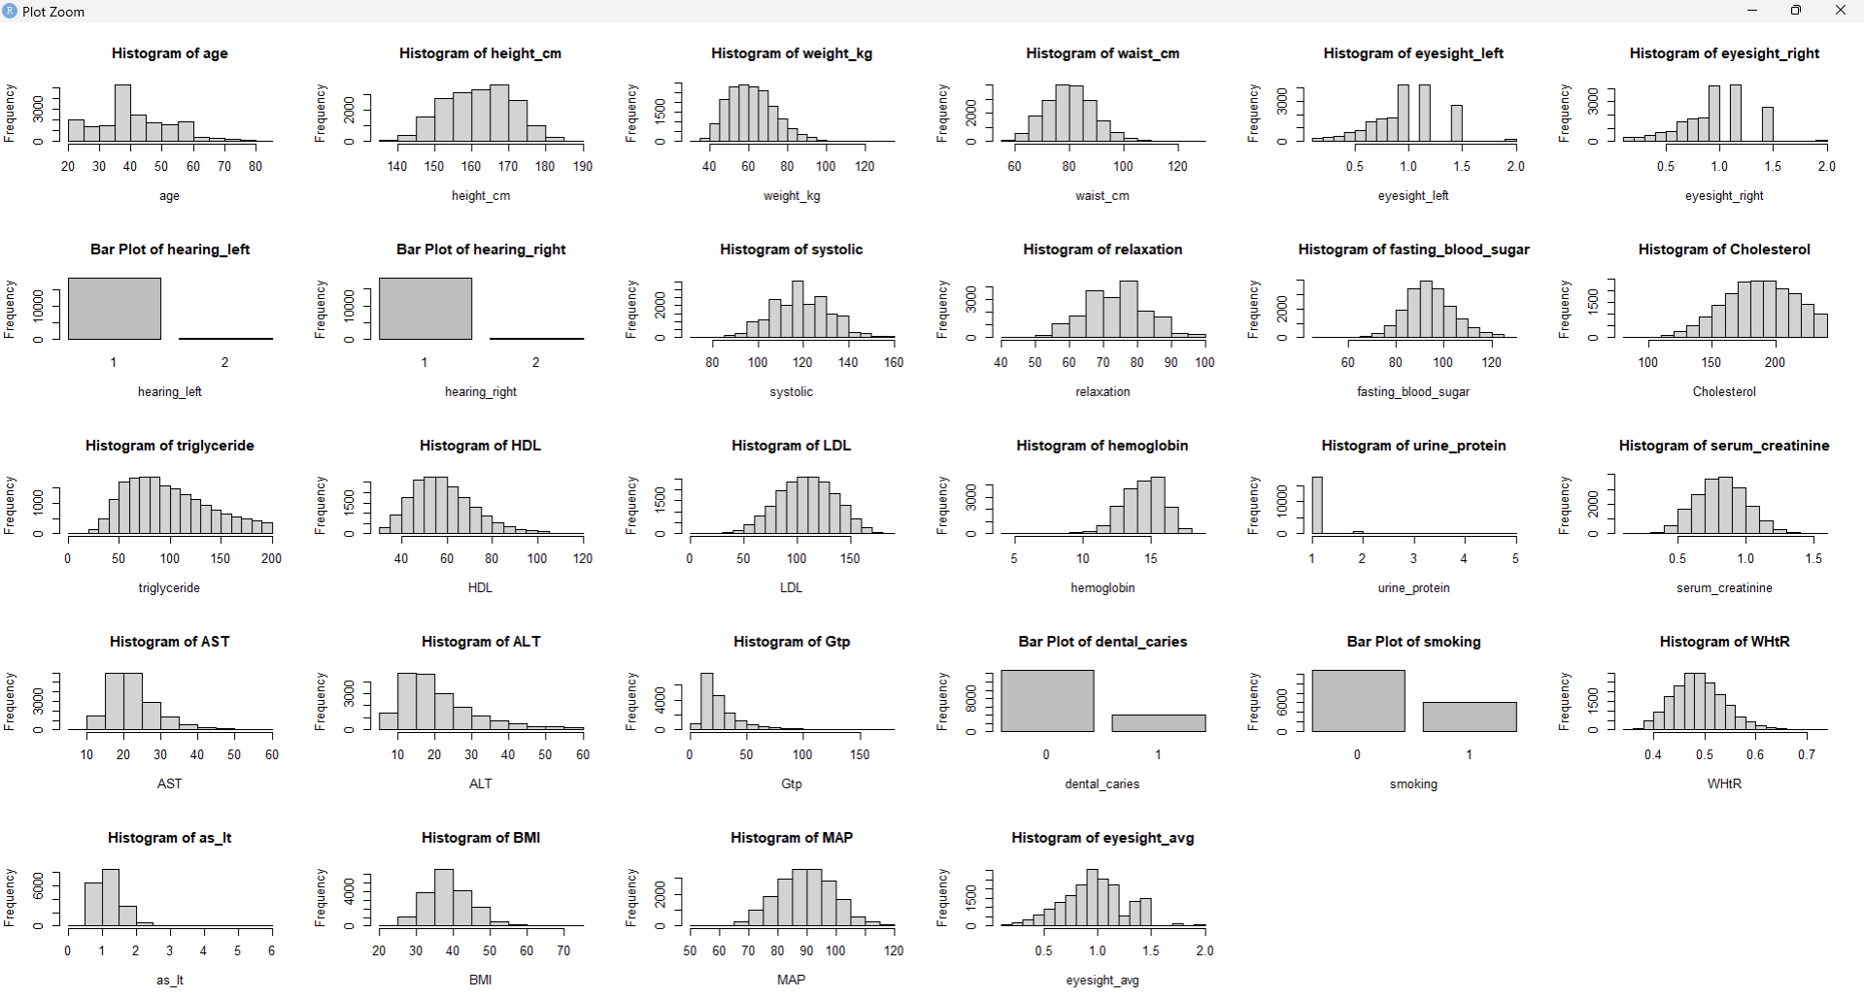
Histograms of Variables after Removal of Outliers

Slide 5
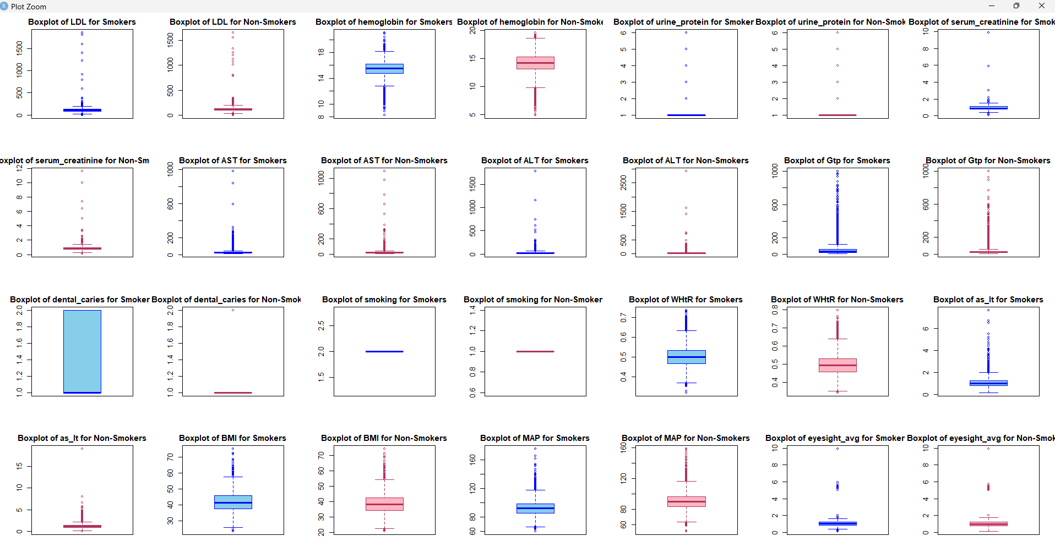
Prior to Removal of Outliers

Slide 6
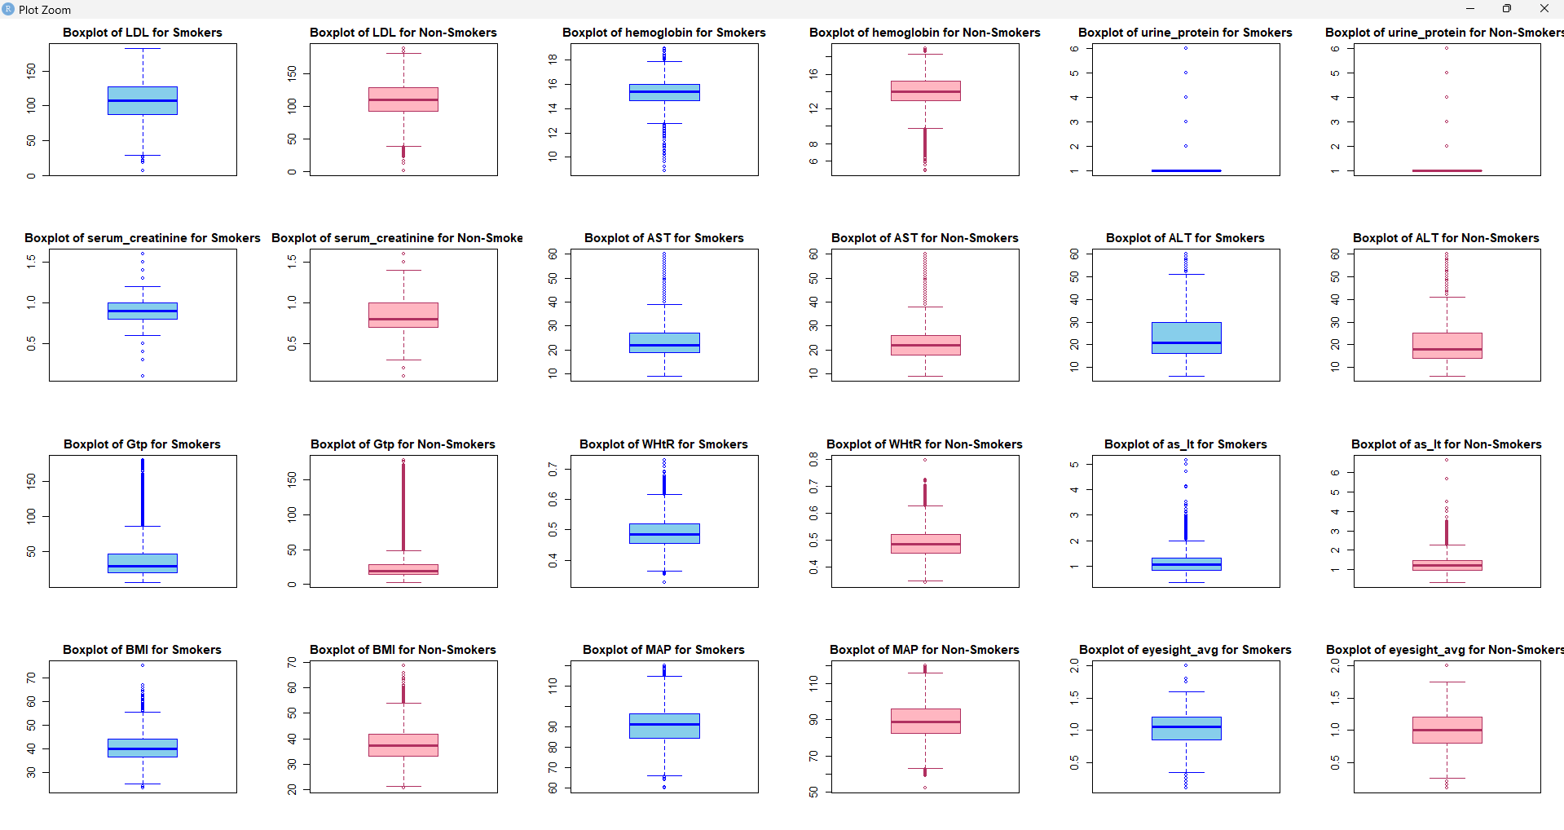
Prior to Removal of Outliers

Slide 7
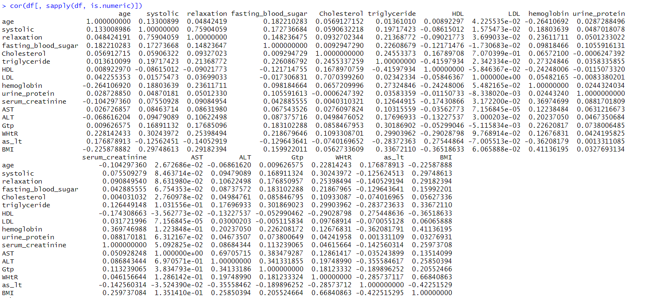



























Data Correlations Before Removing Outliers
Yellow -> Autocorrelations (Diagonal)
Blue -> >=40% Correlations
Pink -> >=30% Correlations

Slide 8
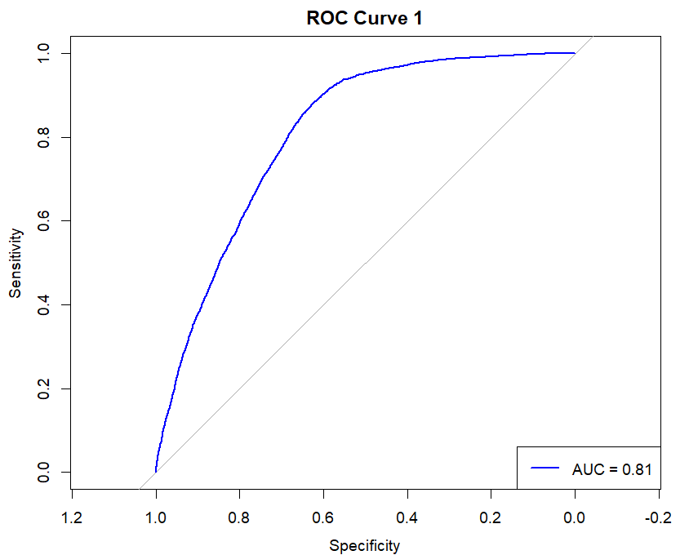
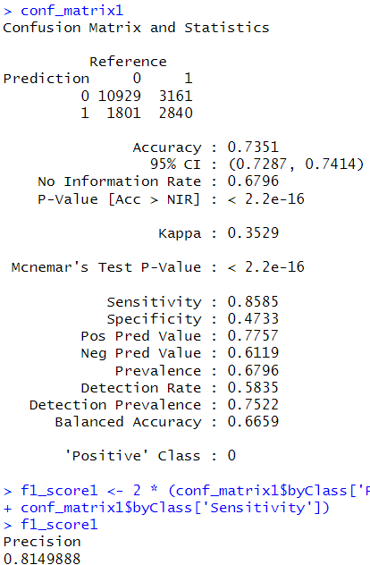
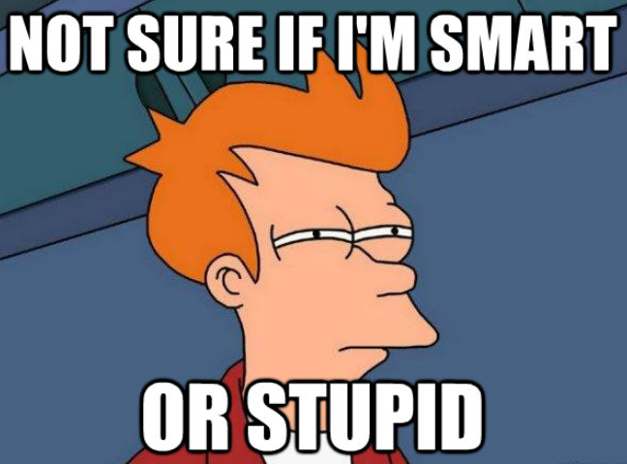
Fit the Model on all parameters
glm.fits1
Boom
Did Nothing and Accuracy ~ 73%
AUC ~ 81.5%

Slide 9

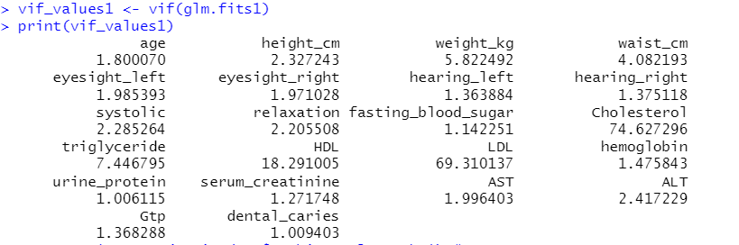
But Who will take Consideration of the Inflated Variation ?

Slide 10
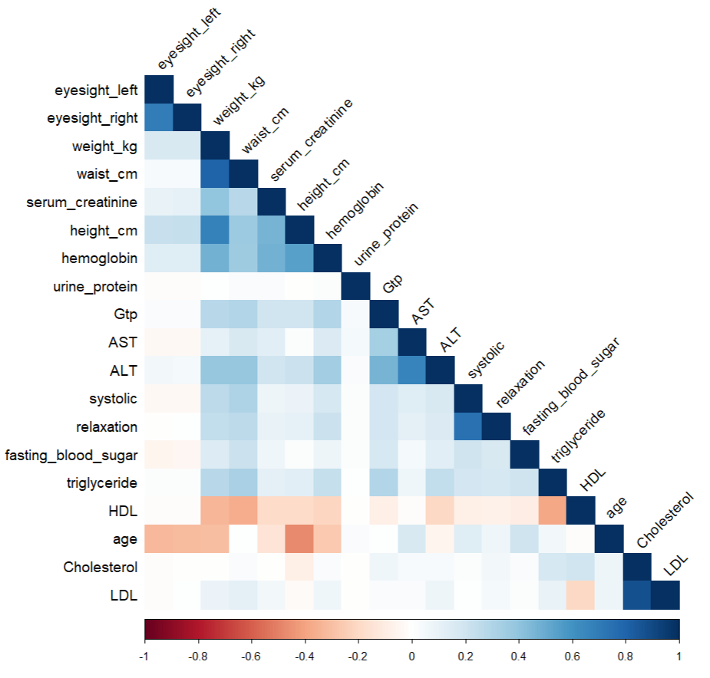
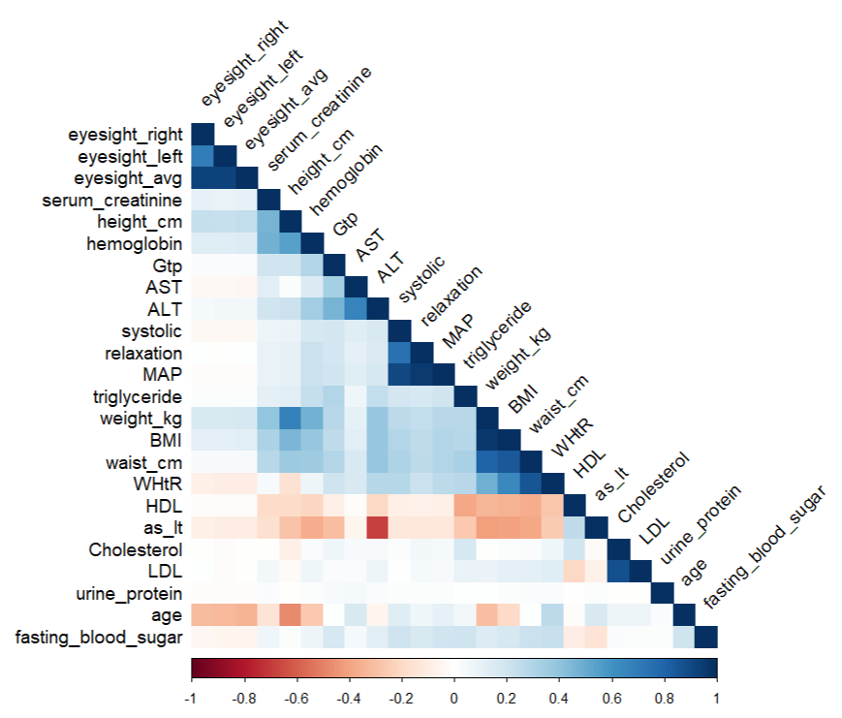
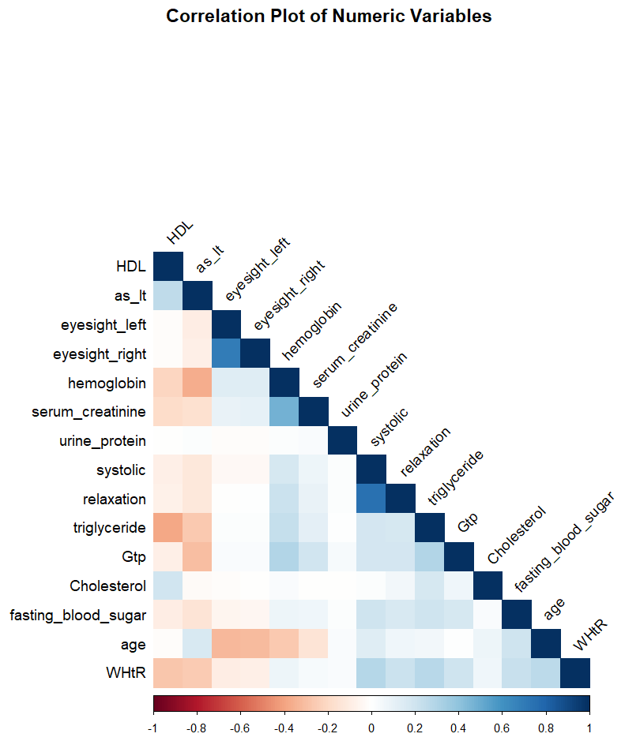
Correlation Matrix (Original Dataset)
Correlation Matrix (Training Dataset with Featured Predictors)
Correlation Matrix of Numeric Variables in Training Data

Slide 11
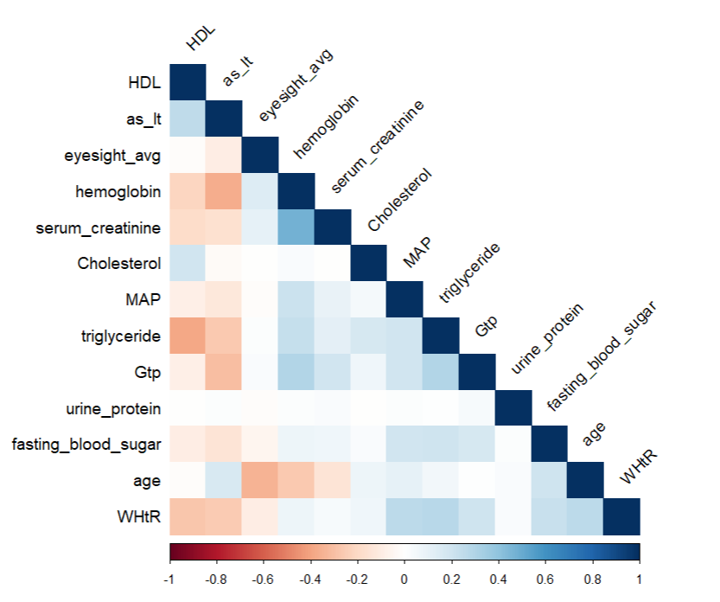
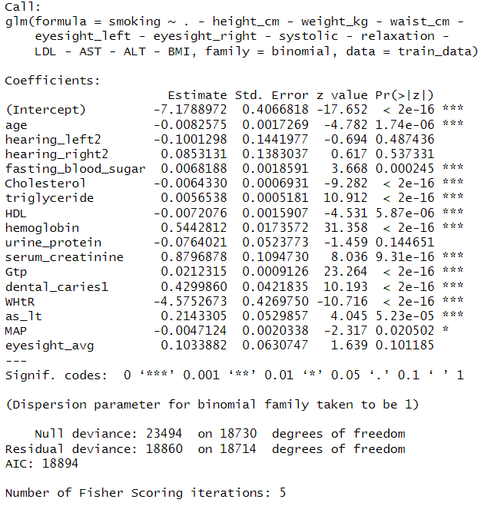
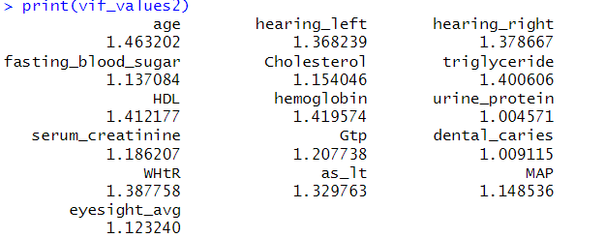
glm.fits2 – Fit Model on Selected Parameters (Removing Correlated Predictors)
Correlation Matrix of Fitted Variables

Slide 12
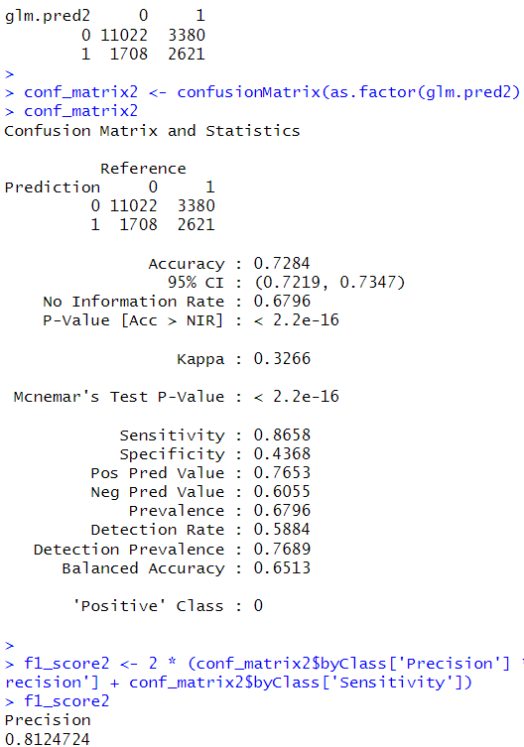
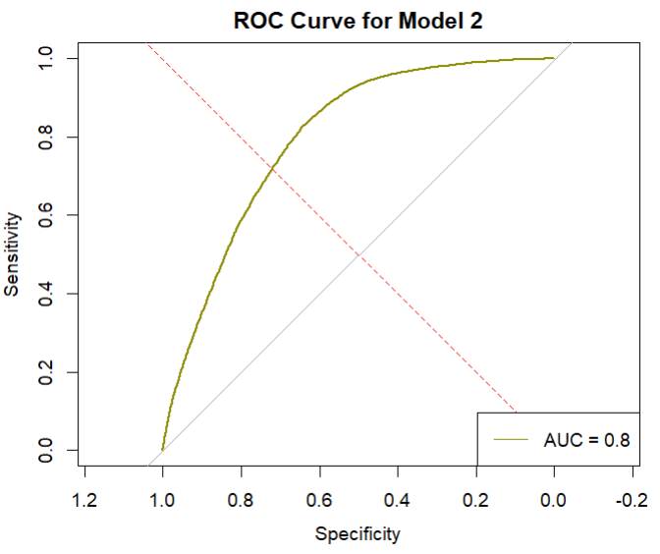

Slide 13
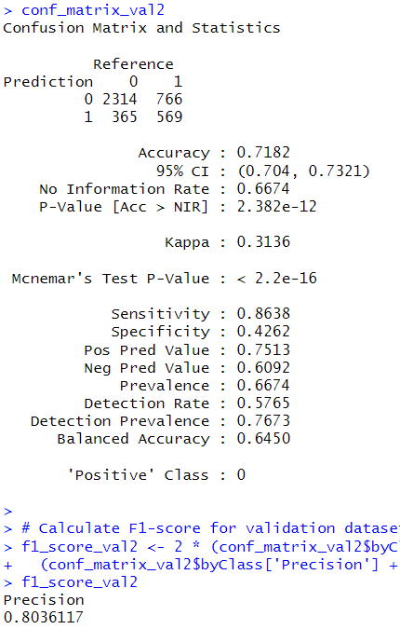
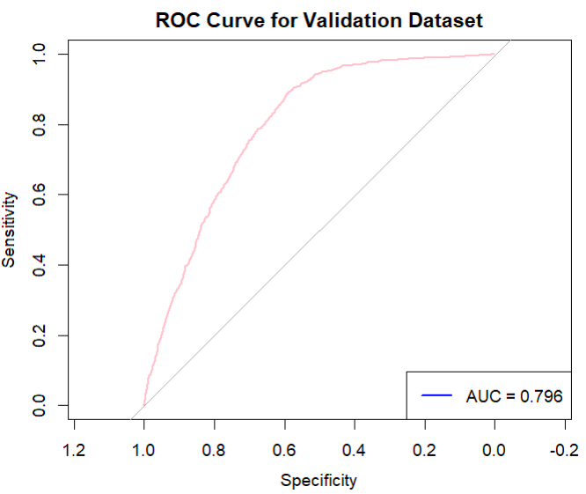
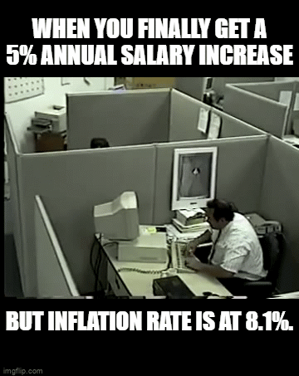
An Accuracy of 72% ?

Slide 14
Application Of Random Forest
Implemented Methodology :
Split the data into training, validation, and test sets, tuning the model using the validation set, and evaluating the final model using the test set.
1. Model Training and Tuning:
Training the Random Forest models with different numbers of trees using the training data.
Evaluate the models using the validation set and select the best-performing model based on validation accuracy.
2. Model Evaluation:
Evaluated the best model using the test set and calculated the test accuracy. (Also it performed better than the Logistic Regression on the Training and Validation data)
Calculated confusion matrices and F1 scores for the training, validation, and test sets.
Plotted the ROC curves for the training, validation, and test sets to visualize the model's performance in terms of sensitivity and specificity.

Slide 15
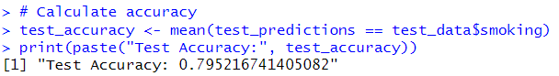
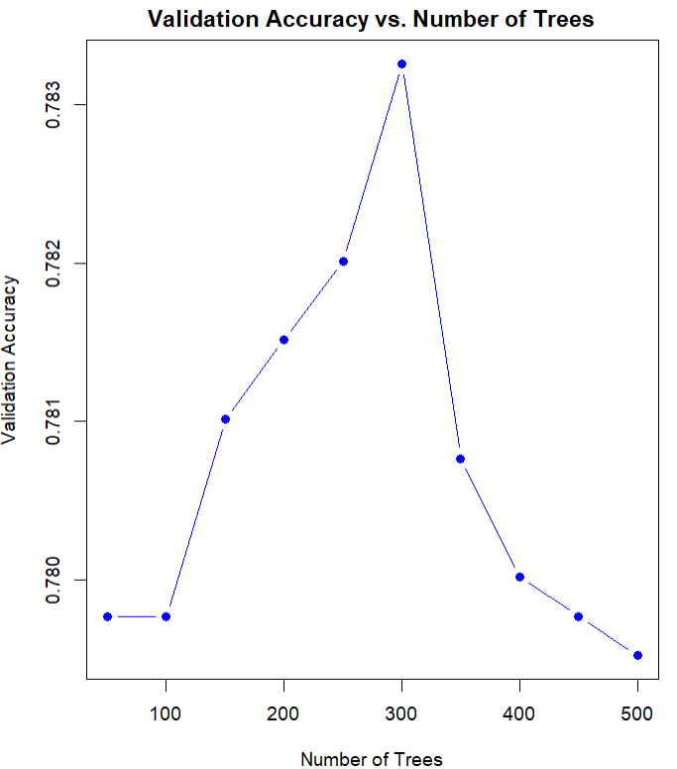
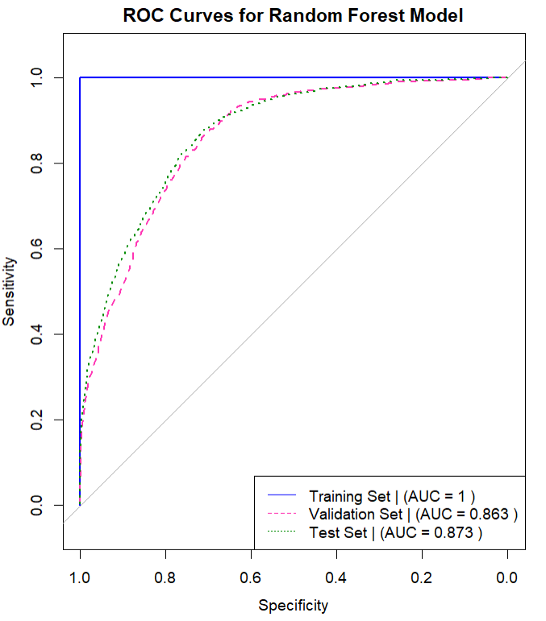

Application Of Random Forest
An Accuracy of 72% ?
~ 7.5% more than “Logistic regression”

Slide 16
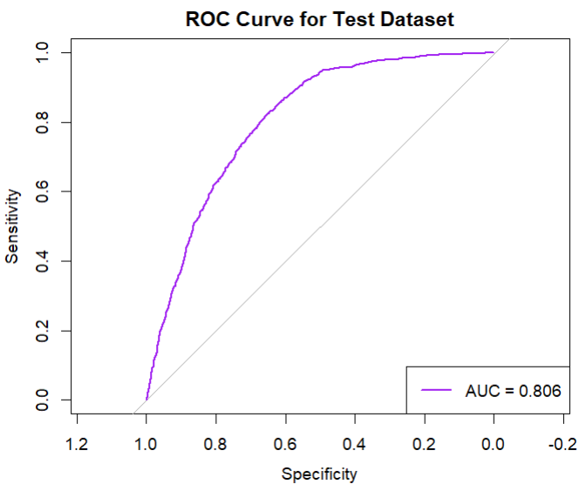
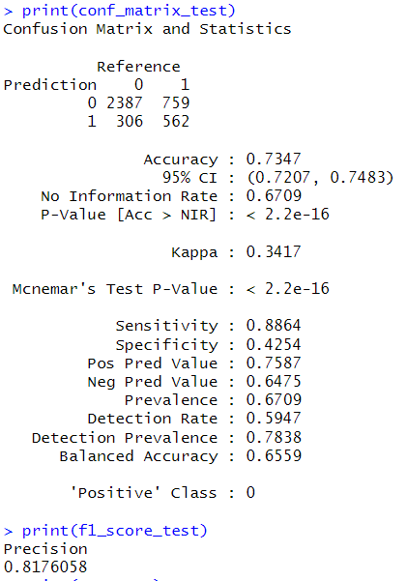
“Curiosity Check” - Logistic Regression on the Test data

Slide 17
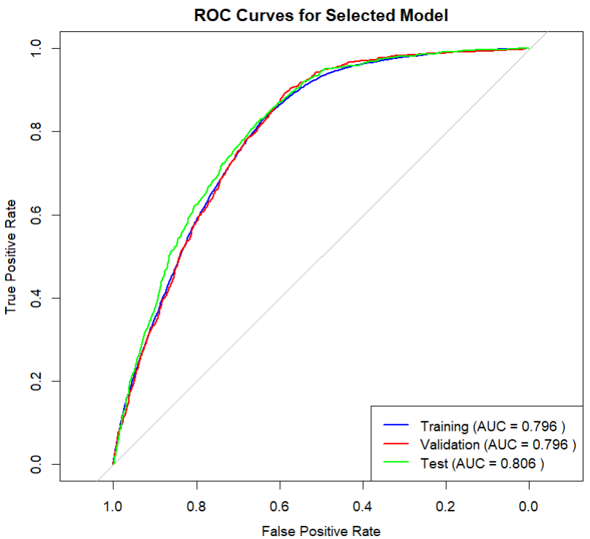
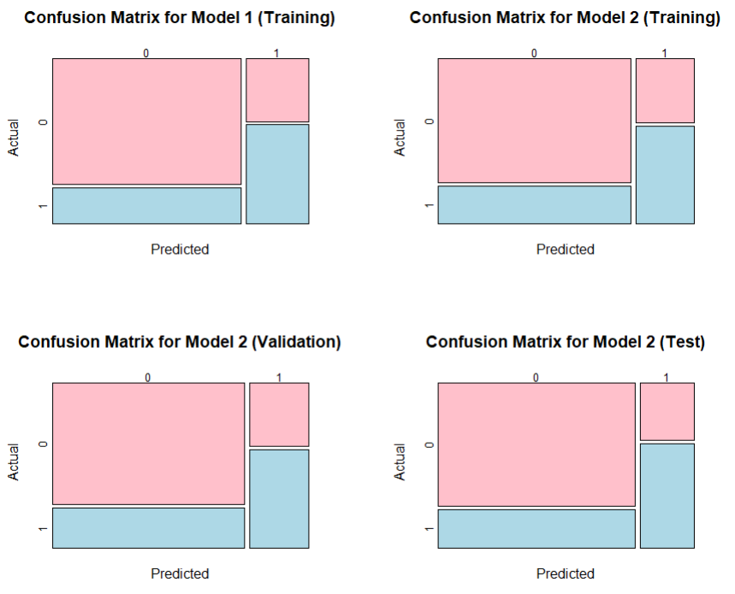
“Curiosity Check”

Slide 18
What else we can do ?
Random Forest ->
We have tuned the number of trees, but we also tune the depth of trees, mtry and other parameters to find maybe a better model (if there is?).
(Not Yet performed though).
So, parked for some other time.

Slide 19
Unsupervised Approach :
Using PCA and K-Means to Cluster the data into Two Parts (Smokers and Non-Smokers)

Slide 20
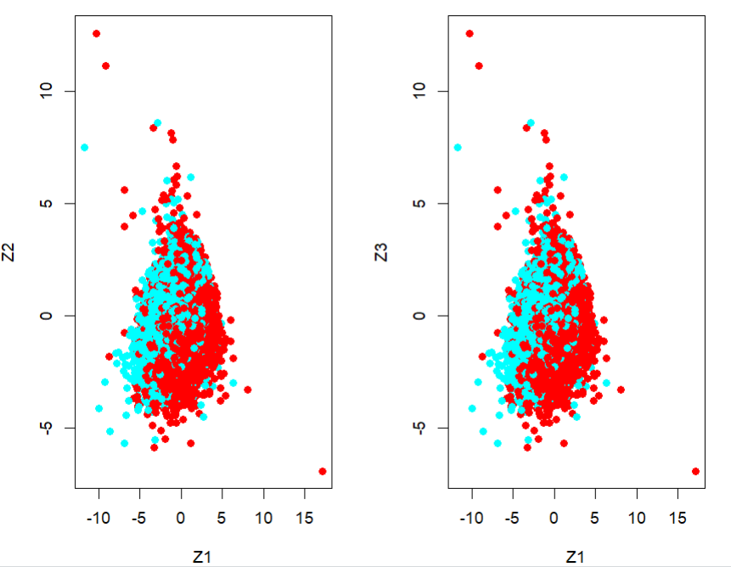
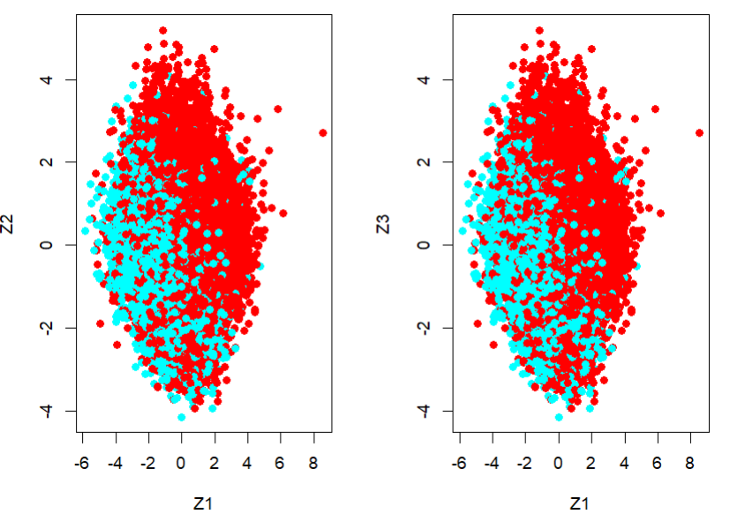
Prior to Removal of Outliers
After Removal of Outliers

Slide 21
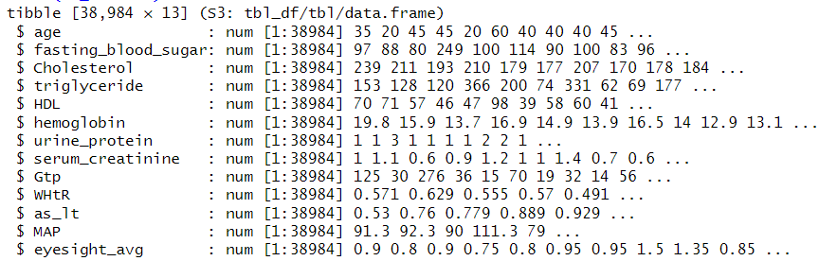
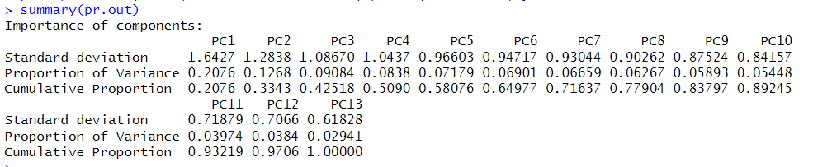
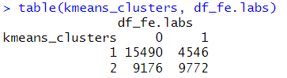

Slide 22
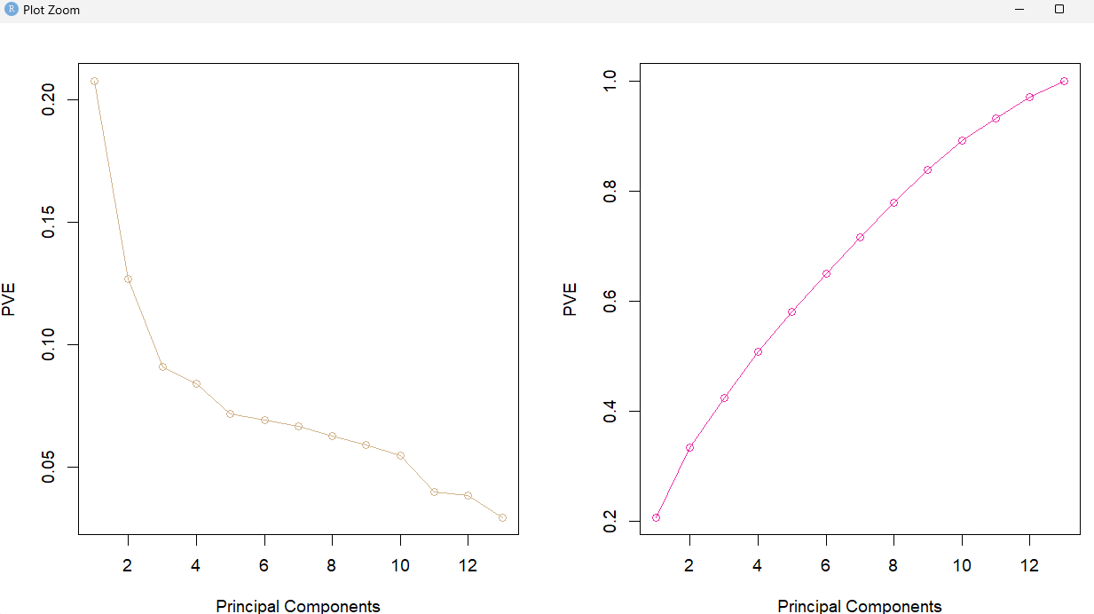
Prior to Removal of Outliers
A silhouette score of 0.1758 suggests that the clusters have some degree of separation, but there may still be some overlap between them.

Slide 23
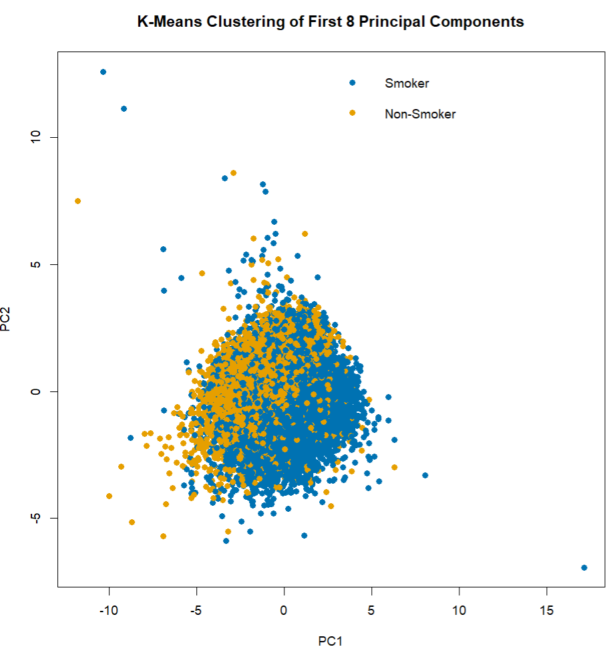
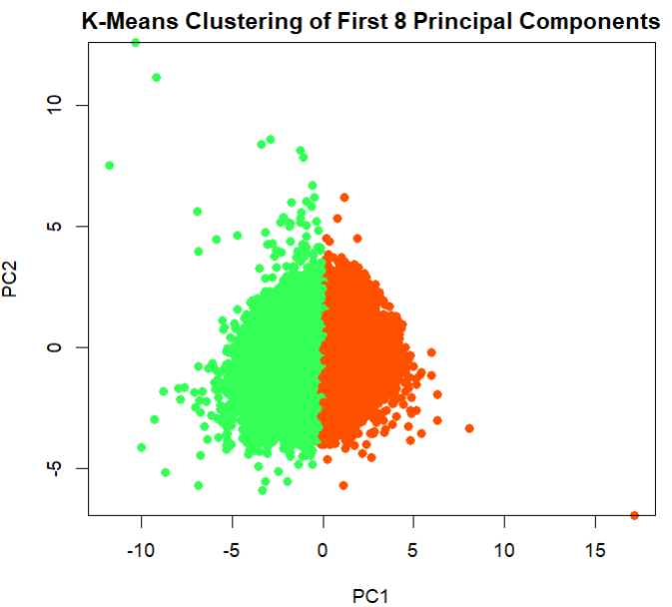
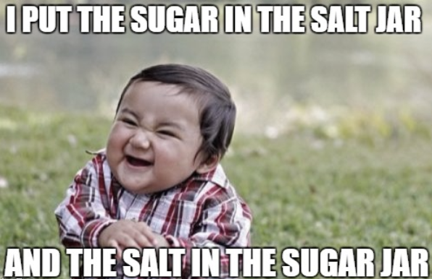
Prior to Removal of Outliers
A silhouette score of 0.1758 suggests that the clusters have some degree of separation, but there may still be some overlap between them.

Slide 24
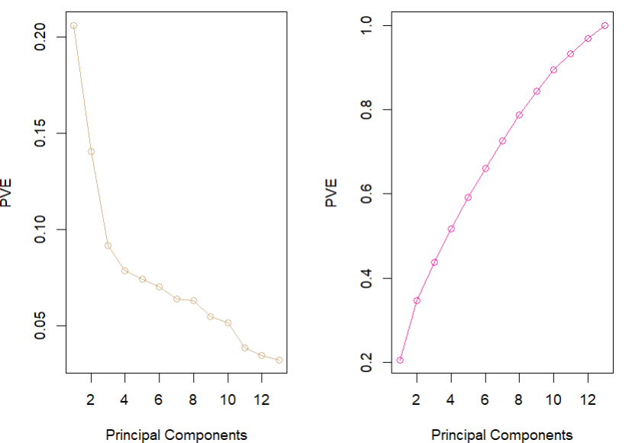
After Removal of Outliers

Slide 25
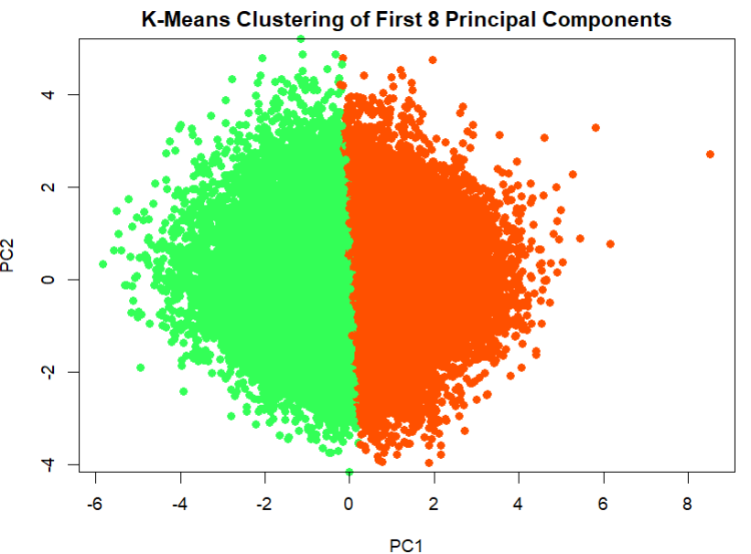
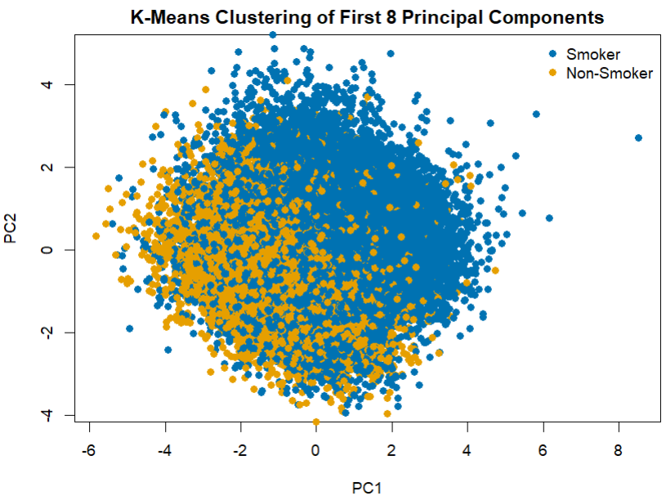
After Removal of Outliers

Slide 26
Appendix
*Snapshots of references used for study

Slide 27
Constraints Used for Removal of Outliers
Cholesterol greater than 240.
LDL (Low-density lipoprotein) greater than 190.
Eyesight in the left eye greater than 2.
Eyesight in the right eye greater than 2.
Fasting blood sugar greater than 126.
Systolic blood pressure greater than 160.
Diastolic blood pressure (relaxation) greater than 100.
Triglyceride greater than 200.
HDL (High-density lipoprotein) less than 30 or greater than 120.
Hemoglobin greater than 19.
Serum creatinine greater than 1.6.
AST (Aspartate transaminase) less than 9 or greater than 60.
ALT (Alanine transaminase) less than 6 or greater than 60.
GTP (Gamma-glutamyl transferase) greater than 180.
*Snapshots of references used for study

Slide 28
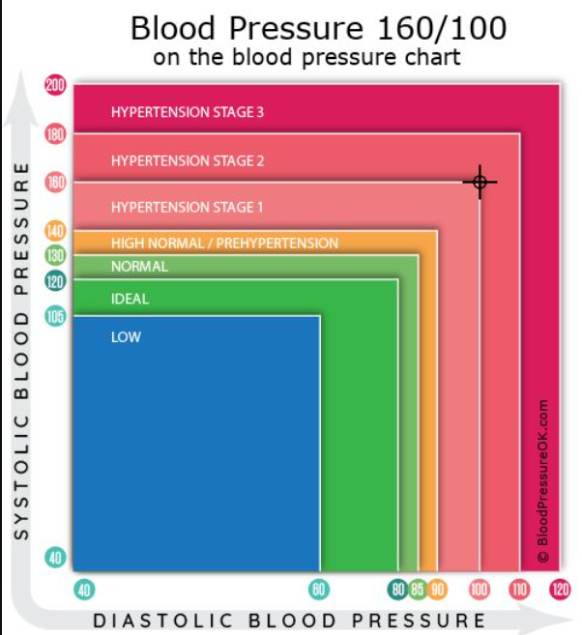
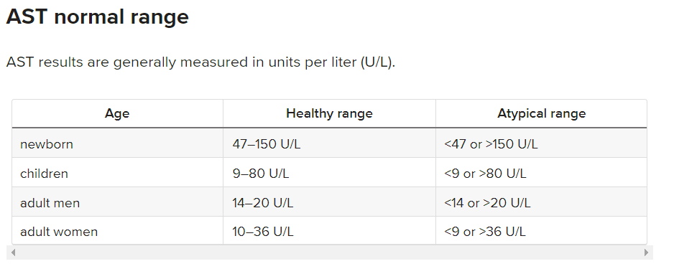
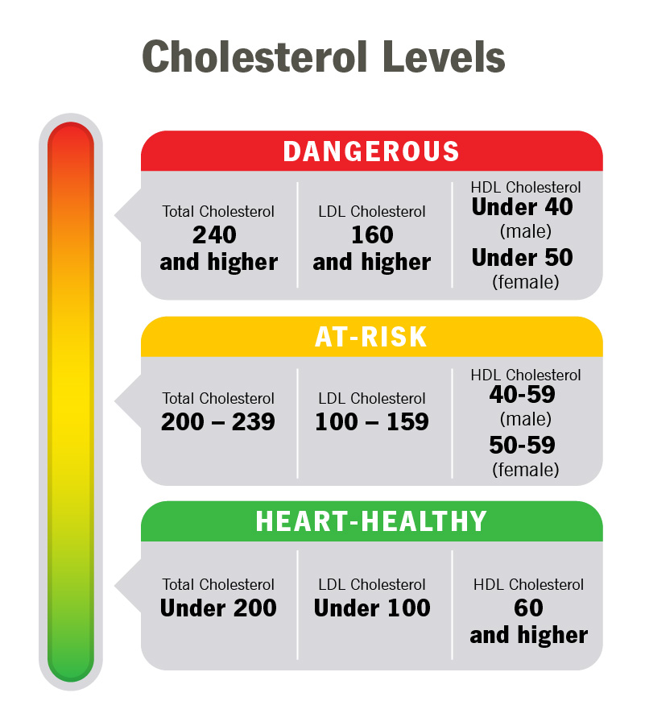
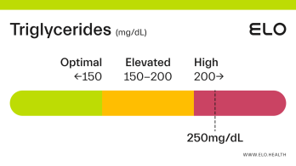

Cholesterol Levels are Averaged Out for Males and Females
Total Cholesterol –
240+ - Dangerous
200-239 -> At Risk
< 200 -> Healthy
LDL
160+ - Dangerous
100 – 159 -> At Risk
< 100 -> Healthy
HDL
< 45 - Dangerous
45 – 60 > At Risk
60+ -> Healthy
Source: https://my.clevelandclinic.org/health/articles/11920-cholesterol-numbers-what-do-they-mean
Triglycerides Levels
200+ - Dangerous
150-200 -> At Risk
< 150 -> Healthy

Slide 29
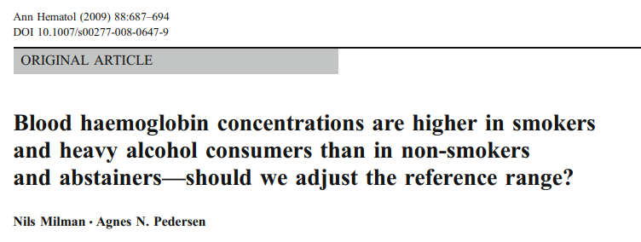



Source: https://hal.science/hal-00535009/document
Source: https://www.mayoclinic.org/tests-procedures/liver-function-tests/about/pac-20394595#:~:text=Standard%20range%20blood%20test%20results,8%20to%2048%20U%2FL%20
Source: https://www.kidney.org/news/kidneyCare/winter09/DontSmoke#:~:text=The%20Surgeon%20General%20issued%20a,your%20kidneys%20are%20under%20stress

Slide 30


Source: https://drlogy.com/calculator/ast-alt-ratio
Source: https://www.ncbi.nlm.nih.gov/pmc/articles/PMC3222662/

Slide 31


Source: https://pubmed.ncbi.nlm.nih.gov/29524646/
Source: https://www.ncbi.nlm.nih.gov/books/NBK538226/

